Slide 1
3 Bytes – CMPS 241
Waed Atwi, Leen Dheini, Anji Abdallah

Slide 2
Medium Bot Features
Attempt to win immediately:
The bot loops through all columns and checks if dropping a piece there would achieve a valid winning move through checkWin().
Block opponent’s immediate win
Used checkOpponentWin() to get the opponent’s winning move and place the bot’s piece there
Prefer central columns
Fallback to random moves if no other option

Slide 3
Medium Bot Complexity
Attempt to win immediately: O(R×C)=O(42) =O(1)
Block opponent’s immediate win: O(R×C)=O(42) =O(1)
Prefer central columns: O(R×C^2) =O(294) = O(1)
Fallback to random moves if no other option: O(C) = O(1)
Overall Complexity: O(C^2 ×R) = O(72 ×6) = O(294) = O(1)

Slide 4
Hard Bot Features
1. Minimax Algorithm with Alpha-Beta Pruning
-Searches the game tree to a fixed depth (depth = 11).
-Alpha-beta reduces unnecessary branches, improving efficiency
2. Transposition Table with Zobrist Hashing
-Stores previously evaluated positions to avoid redundant calculations.
-Supports fast lookups and stores the best move for each position
3. Opening Table
-Guarantees optimal first 1–3 moves, ensuring strong early-game play.

Slide 5
4. Evaluation Function Scores positions based on:
-4-in-a-row and 3-in-a-row patterns
-Center column preference
-Immediate threats (win/block)
-Potential three-in-a-row setups
5. Threat-Driven Move Ordering
-Moves that win immediately or block opponent are evaluated first.
-Fork creation and blocking prioritized to reduce risk of traps
6. Null-Move Pruning
-Skips moves in certain positions to speed up evaluation while maintaining accuracy

Slide 6
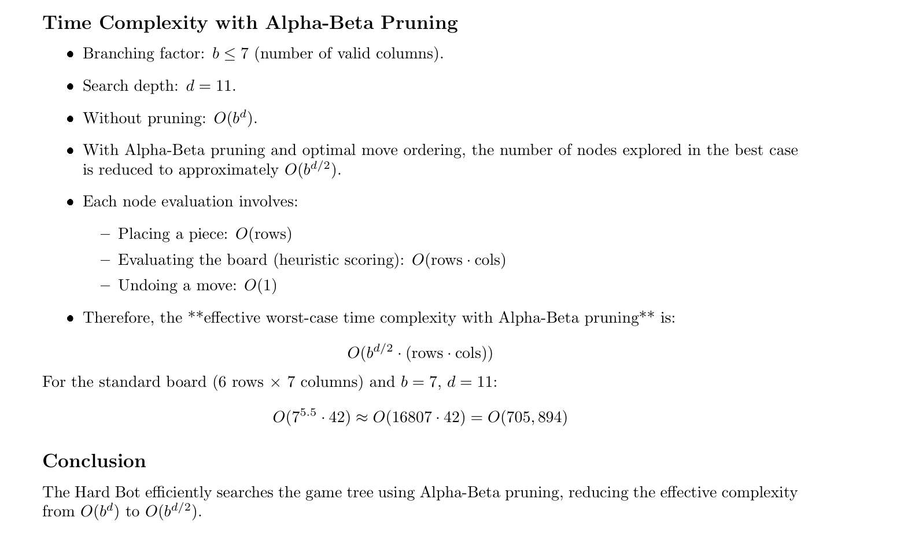

Slide 7
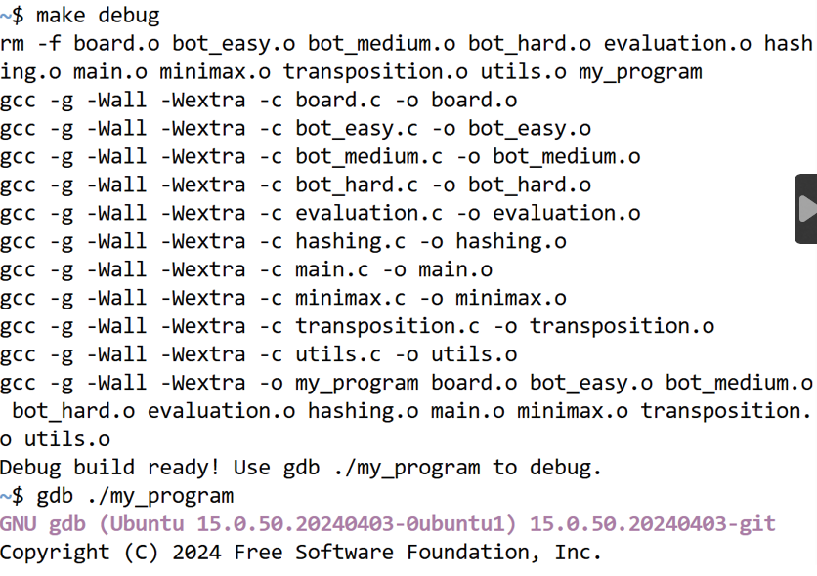
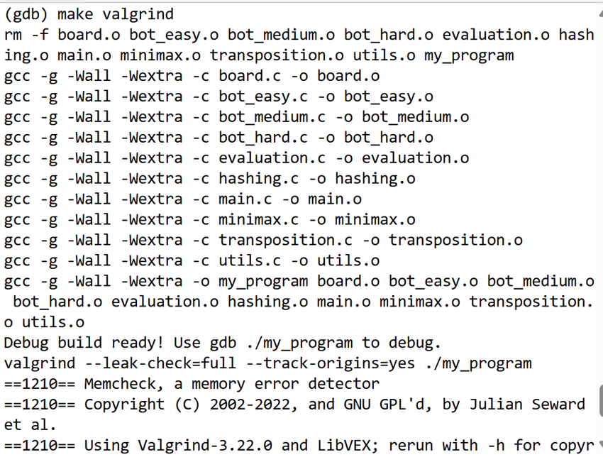
Debugging
GDB
Valgrind

Slide 8
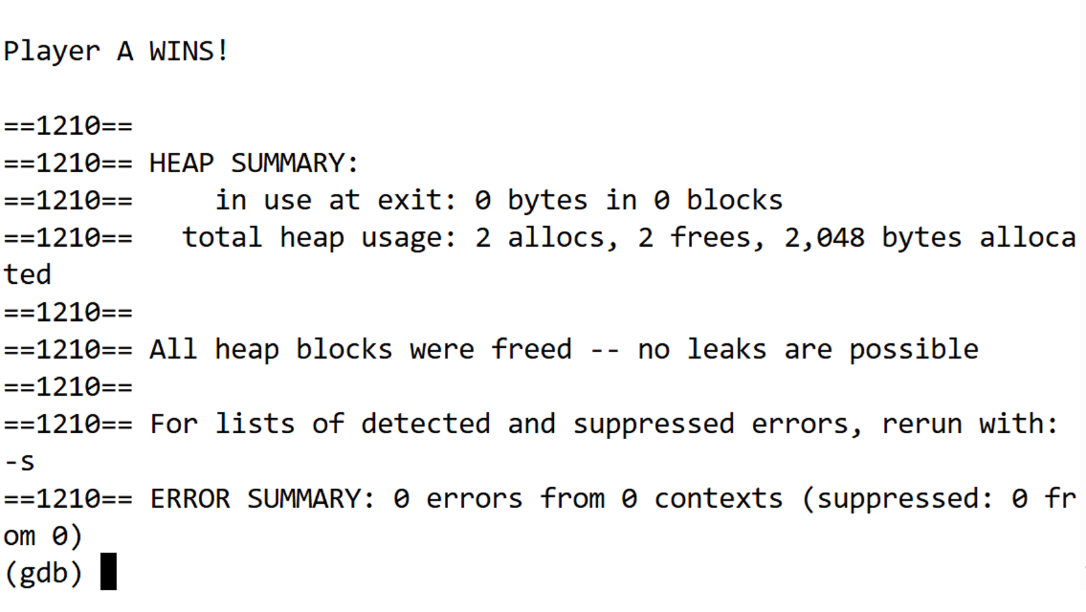
Valgrind Results

Slide 9
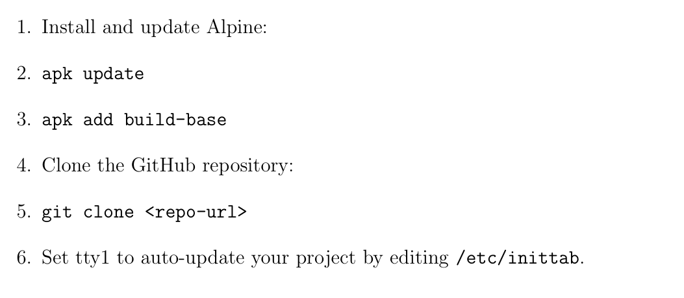
Extra Features
Alpine

Slide 10
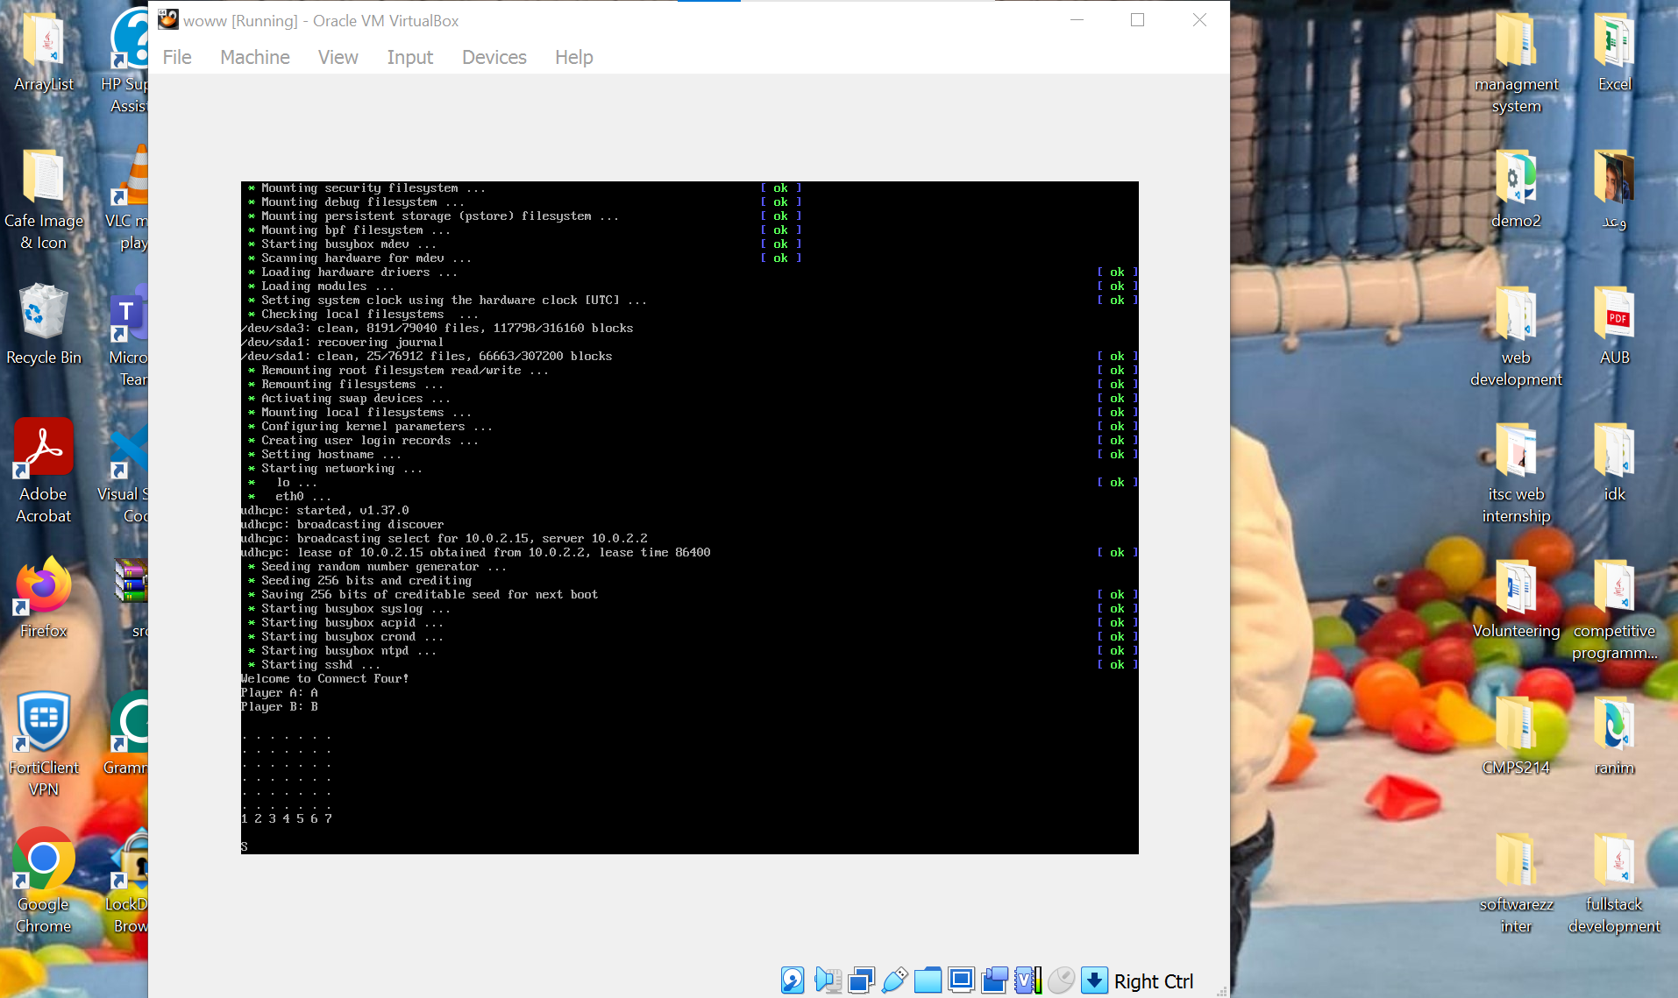

Slide 11
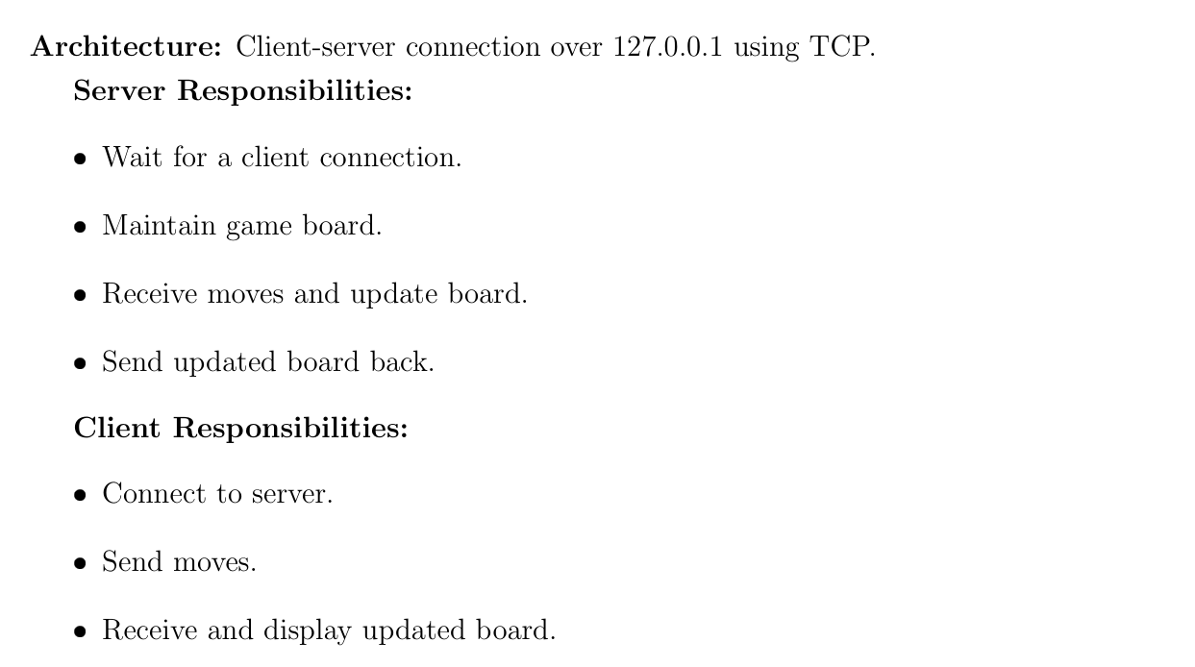
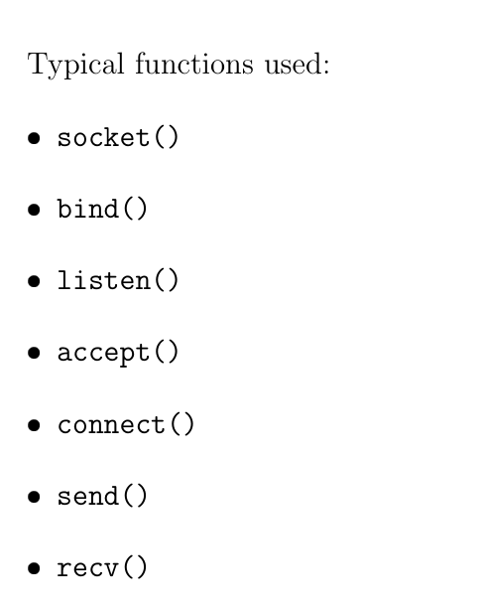
Networking

Slide 12
